Slide 1

Engine Measurement Dashboard
Team members: John DeJarnette, Bryant Boatright, Colton Wirth, Darius Baker, Devin Dunford, Jared Belser, Jesse Clemence, and Kyler Clark

Slide 2
Project Progress (Gantt Chart)
 |  | Feb. |  | March |  |  |  |  |  |  |  |  |  |  |  |  |  |  |  |  |  |  |  |  |  |  |  |  |  |  |  |  |  |  | April
 | Tasks | 27 | 28 | 1 | 2 | 3 | 4 | 5 | 6 | 7 | 8 | 9 | 10 | 11 | 12 | 13 | 14 | 15 | 16 | 17 | 18 | 19 | 20 | 21 | 22 | 23 | 24 | 25 | 26 | 27 | 28 | 29 | 30 | 31 | 1 | 2 | 3 | 4 | 5 | 6 | 7 | 8 | 8 | 9 | 10 | 11 | 12 | 13 | 14 | 15 | 16 | 17 | 18 | 19 | 20 | 21 | 22 | 23 | 24
 | 1) Collaborating with the other groups to obtain data
 | 2) Working out file operations and general I/O
 | 3) Setting up the equations for finding calculated values
 | 4) Setting up Dashboard components
 | 5) Writing up the final report
 | 6) Testing our system
 | 7) Giving the final demonstration
 | 8) Preparing the final presentation
 | 9) Giving the final presentation

Slide 3
Project Progress
Dashboard displays parameters stated in project requirements
Interface with data collection system is not complete
Awaiting a finalized data input system from Group 2
Currently generating simulated data
Manual created for general usage and further development

Slide 4
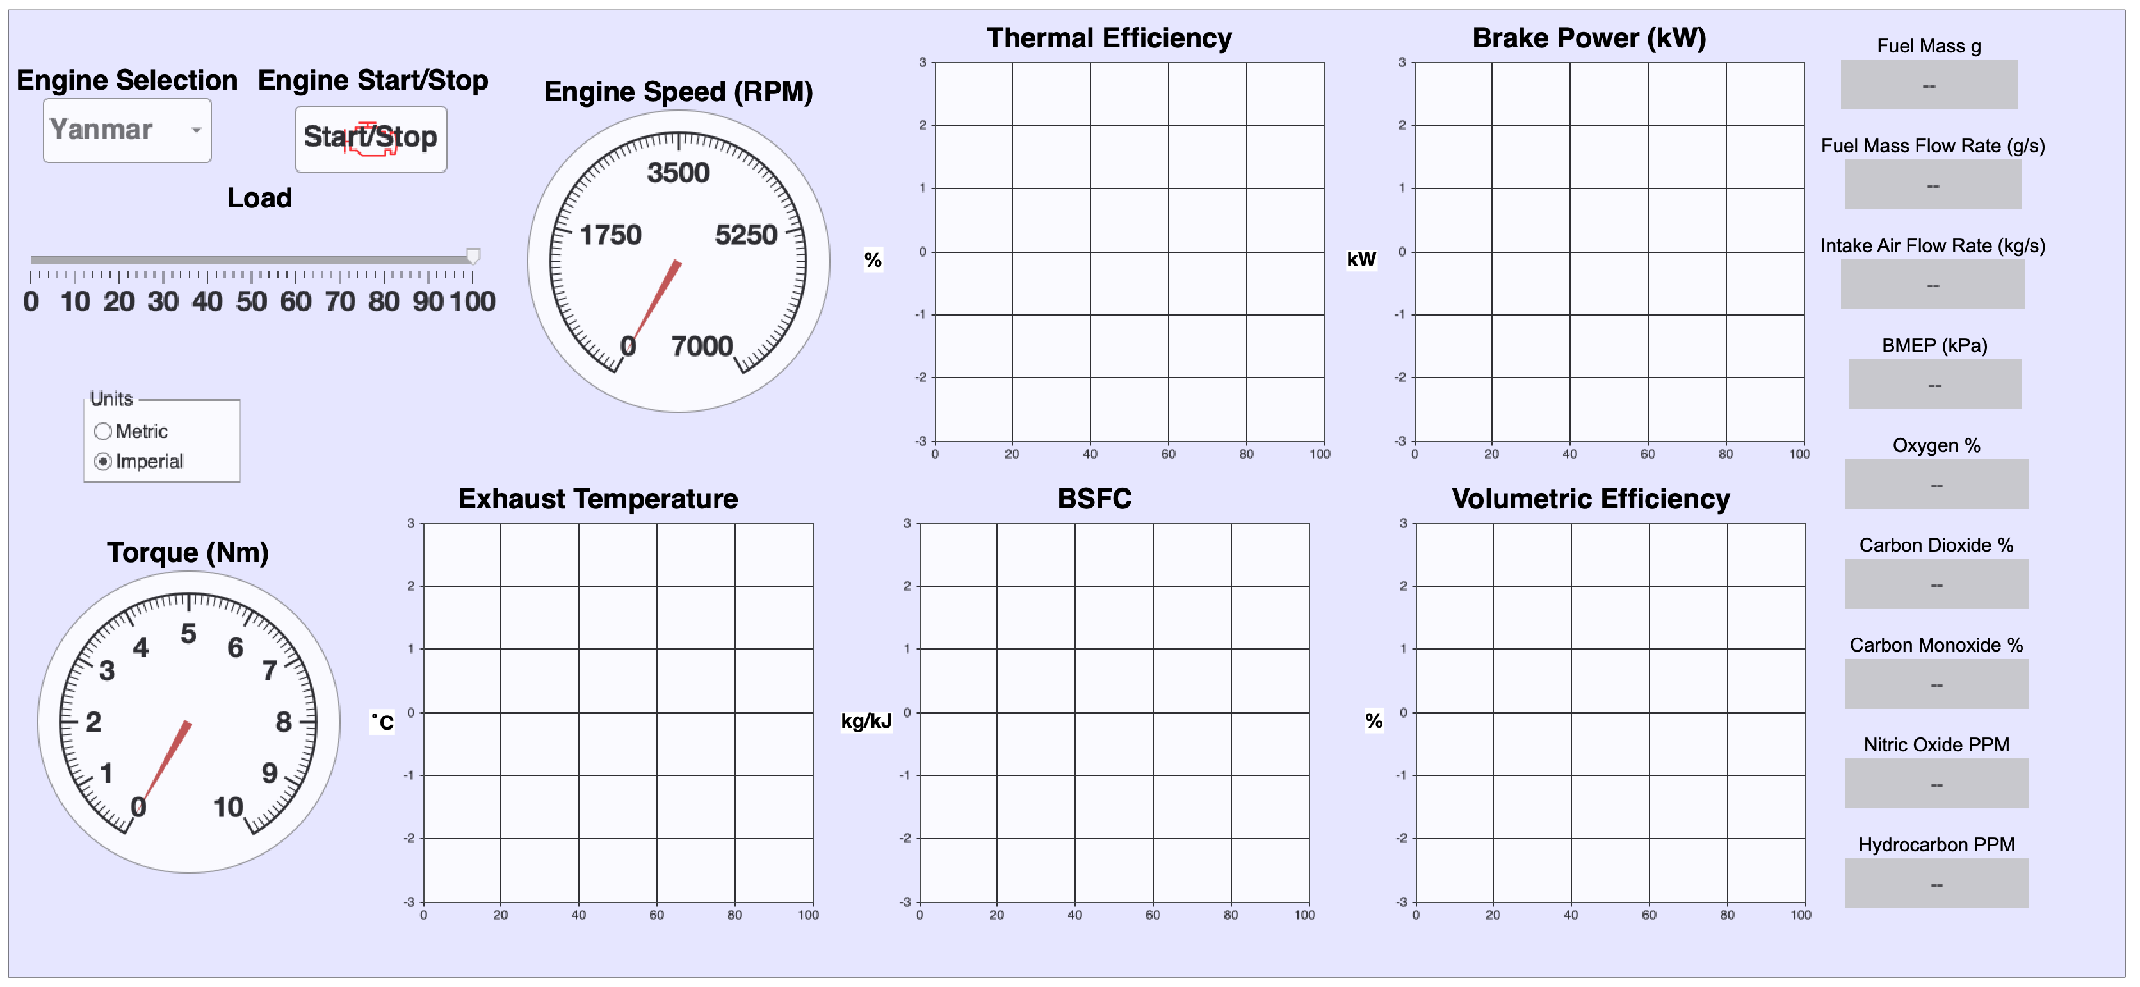
Current State

Slide 5
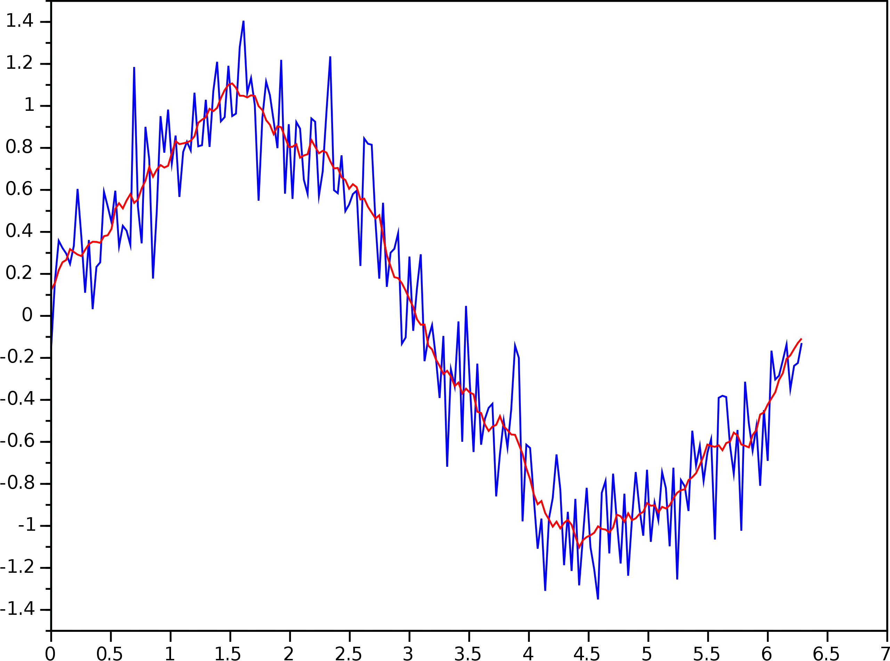
Weaknesses, Issues, Future Work
Simulink has powerful development platform with some quirks
Key benefit of Simulink is real time modeling
Other free/paid software platforms exist but not necessarily better
Alternative methods to GUI development in Simulink
Goal of separating dashboard from model
AppDesigner, UIFigures, MATLAB Live Editor
Consider other project management methods in Simulink
Git integration with MATLAB/Simulink
Explore more complex post-processing methods
Develop rolling average display for parameters to reduce noise in signal

Slide 6
Project Take Aways
UI/UX design is an iterative process that is never fully complete
Refinements can always be made
Balance needed between improving design and diminishing return on investment
Avoid overcomplicating block diagrams
Simulink often has a function block that simplifies complex designs.
Ex: derivative function block

